Slide 1
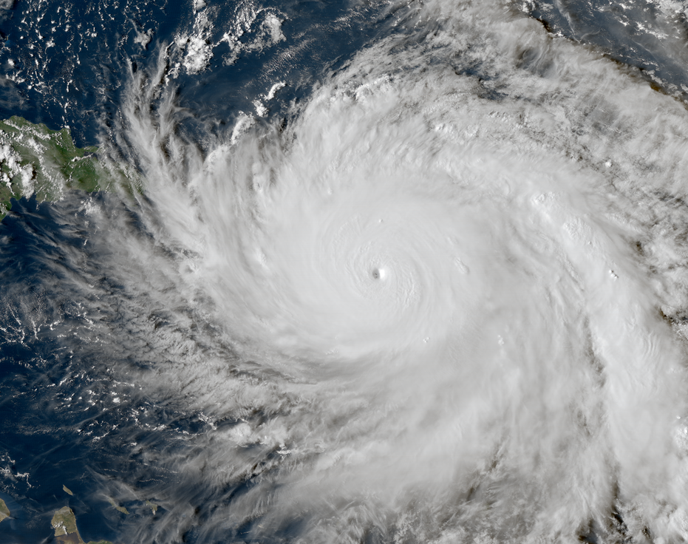
Challenges of Integrating Physical Exposure and Human Impacts Data in Tropical Cyclone Studies
Matthew Hughes, M.S. Graduate Student, Environmental Health – Epiodemiology
Brooke Anderson, PhD, Environmental Health – Epidemiology
Colorado State University, College of Veterinary Medicine and Biomedical Science

Slide 2
Introduction
Tropical cyclones regularly threaten coastal communities in the Eastern and Southeastern United States
Tropical cyclones are highly destructive, causing lasting damage to coastal infrastructure, local economies, and human health. Between 2000 and 2019, tropical cyclones in the United States were responsible for:
$811 billion in damages
6,010 deaths (average of 301 deaths per year)

Slide 3
The Challenge: Spatial and Temporal Misalignment
Studying the effects that tropical cyclones have on communities requires using data on physical exposures (wind speed, precipitation, etc.) and human impacts (property damage, economic disruption, health effects, etc.)
Physical Exposures:
Large continentwide networks of weather monitors and sensors
Large spatial scales (entire continents)
Very fine (sometimes continuous) temporal scales
Human Impacts:
Administrative data sources, hospitalization records, vital records
Aggregated spatial scales (often based on political or administrative boundaries)
Temporal scales depend on impact being studied (hospitalization records are recorded by day, while pregnancies are recorded in weeks)

Slide 4
Spatial and Temporal Scales
Spatial Scales
Temporal Scales
Point Locations
Zip code/Parish/County
Metropolitan Area
State
Multi-state Region/Country
Seconds/Minutes/Hours
Day
Week
Cumulative Measures of Time

Slide 7
Integrating Physical Exposure Datasets with Human Impact Datasets
Aggregation
1
e.g. Take the average or maximum wind speed for an entire county during a specific time period
Interpolation
2
e.g. Take individual point location precipitation measurements and smooth them over a surface.
Matching
3
Assign residential addresses (point locations) to the nearest weather station

Slide 8
Implications of these Integration Methods
Ecological Bias
Loss of resolution when categorizing continuous variables
Misclassification

Slide 9
Ecological Bias
Occurs whenever an aggregate association between an exposure and outcome does not properly reflect the association on the individual level
Especially common when a lot of heterogeneity exists in the aggregated population
Not much of a concern when the aggregate value is a count
e.g. The Spatial Hazard Events and Losses Database reports daily casualty counts after natural disasters.

Slide 10
Categorizing Continuous Variables
Appropriate thresholds must be chosen to divide continuous exposure data into bins for assigning exposure to populations or individuals
e.g. Residents of a particular county might be considered exposed if the wind speed exceeded a particular threshold.
Choosing a threshold is often arbitrary
Median?
Categorizing continuous data (especially dichotomizing) loses data.
Makes dose-response relationships harder to detect
Opens the door for misclassification

Slide 11
Misclassification
Misclassification error occurs when exposure and outcome variables are measured in categories and the wrong category is assigned to a particular case/observation
e.g. A case that is exposed is incorrectly categorized as unexposed.
This is an extremely common problem in environmental epidemiology (same with ecological basis)
Can arise from the way that physical exposures are characterized, but also the way that geographic areas are characterized.

Slide 12
